Slide 1
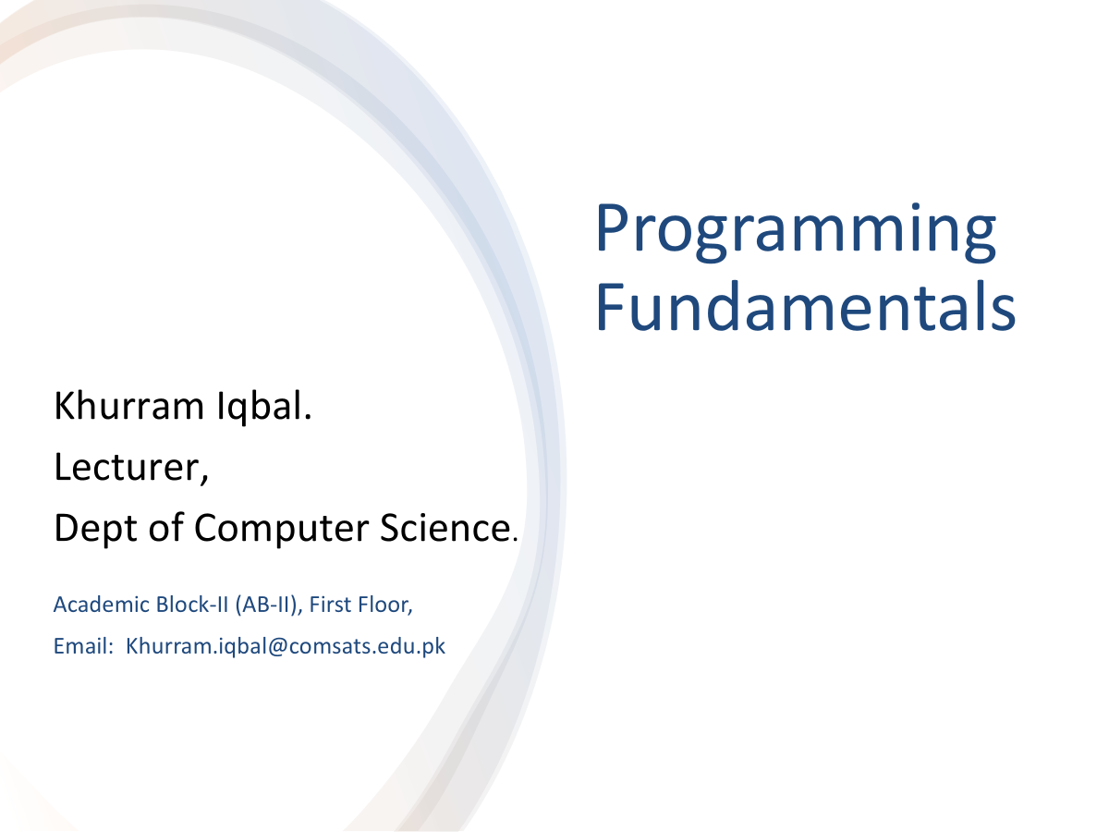

Slide 2
Lecture Outline
Nested if statement
Multi-way if-else if-else statement
Logical Operators
Conditional Expressions

Slide 3
Nested Decision Structures
An if statement can be inside another if statement to form a nested if statement
Example:
Determine if someone qualifies for a loan, they must meet two conditions:
Must earn at least $30,000/year
Must have been employed for at least two years
Check first condition, and if it is true, check second condition

Slide 4
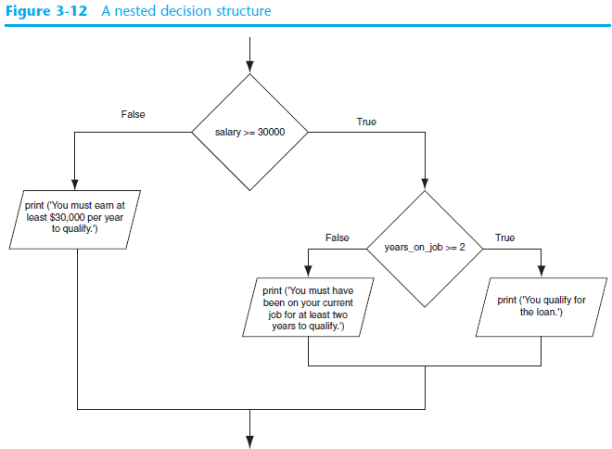
Nested Decision Structures – Example

Slide 5
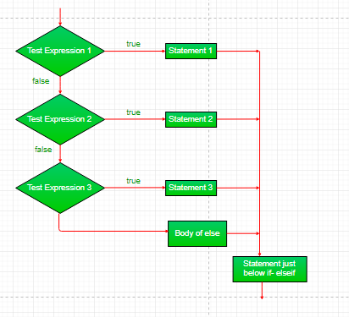
Multiple Alternative if Statements
Syntax
if (condition)
statement;
else if (condition)
statement;
. .
else
statement;

Slide 6
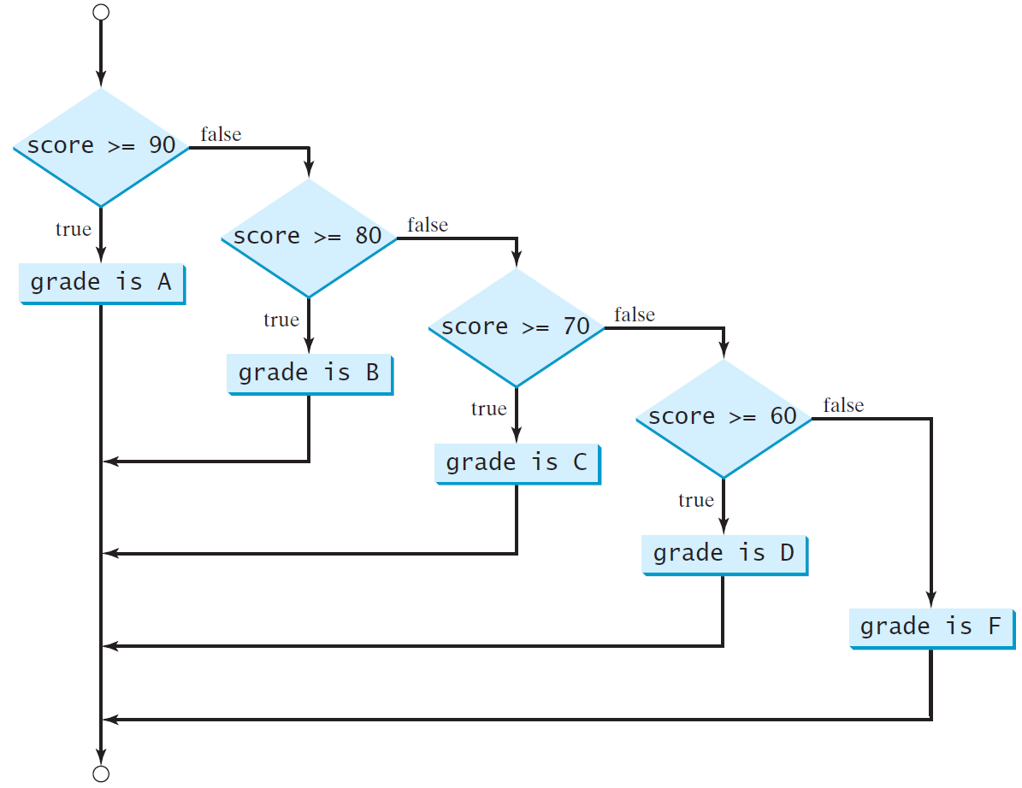
Multi-Way if-else Statements

Slide 7
Multiple Alternative if Statements

Slide 8
Trace if-else statement
Suppose score is 70.0
The condition is false
if (score >= 90.0)
System.out.print("A");
else if (score >= 80.0)
System.out.print("B");
else if (score >= 70.0)
System.out.print("C");
else if (score >= 60.0)
System.out.print("D");
else
System.out.print("F");

Slide 9
Trace if-else statement
Suppose score is 70.0
The condition is false
if (score >= 90.0)
System.out.print("A");
else if (score >= 80.0)
System.out.print("B");
else if (score >= 70.0)
System.out.print("C");
else if (score >= 60.0)
System.out.print("D");
else
System.out.print("F");

Slide 10
Trace if-else statement
Suppose score is 70.0
The condition is true
if (score >= 90.0)
System.out.print("A");
else if (score >= 80.0)
System.out.print("B");
else if (score >= 70.0)
System.out.print("C");
else if (score >= 60.0)
System.out.print("D");
else
System.out.print("F");

Slide 11
Trace if-else statement
Suppose score is 70.0
grade is C
if (score >= 90.0)
System.out.print("A");
else if (score >= 80.0)
System.out.print("B");
else if (score >= 70.0)
System.out.print("C");
else if (score >= 60.0)
System.out.print("D");
else
System.out.print("F");

Slide 12
Trace if-else statement
Suppose score is 70.0
Exit the if statement
if (score >= 90.0)
System.out.print("A");
else if (score >= 80.0)
System.out.print("B");
else if (score >= 70.0)
System.out.print("C");
else if (score >= 60.0)
System.out.print("D");
else
System.out.print("F");

Slide 13
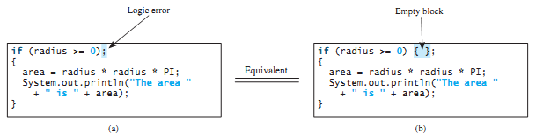
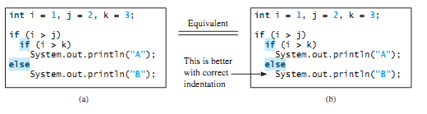
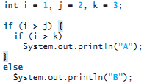
Wrong Semicolon at the if Line
Dangling else ambiguity
The else clause always matches the most recent unmatched if clause in the same block
To force the else clause to match the first if clause, you must add a pair of braces

Slide 14
What is wrong in the following code?
if (score >= 60.0)
System.out.println("D");
else if (score >= 70.0)
System.out.println("C");
else if (score >= 80.0)
System.out.println("B");
else if (score >= 90.0)
System.out.println("A");
else
System.out.println("F");
Suppose x = 2 and y = 3. Show the output, if any, of the following code. What is
the output if x = 3 and y = 2? What is the output if x = 3 and y = 3?
if (x > 2)
if (y > 2) {
int z = x + y;
System.out.println("z is " + z);
}
else
System.out.println("x is " + x);

Slide 15

Equality Test of Two Floating-Point Values
double x = 1.0 - 0.1 - 0.1 - 0.1 - 0.1 - 0.1;
System.out.println(x == 0.5);
x is not exactly 0.5, but is 0.5000000000000001
Simplifying Boolean Variable Assignment

Slide 16
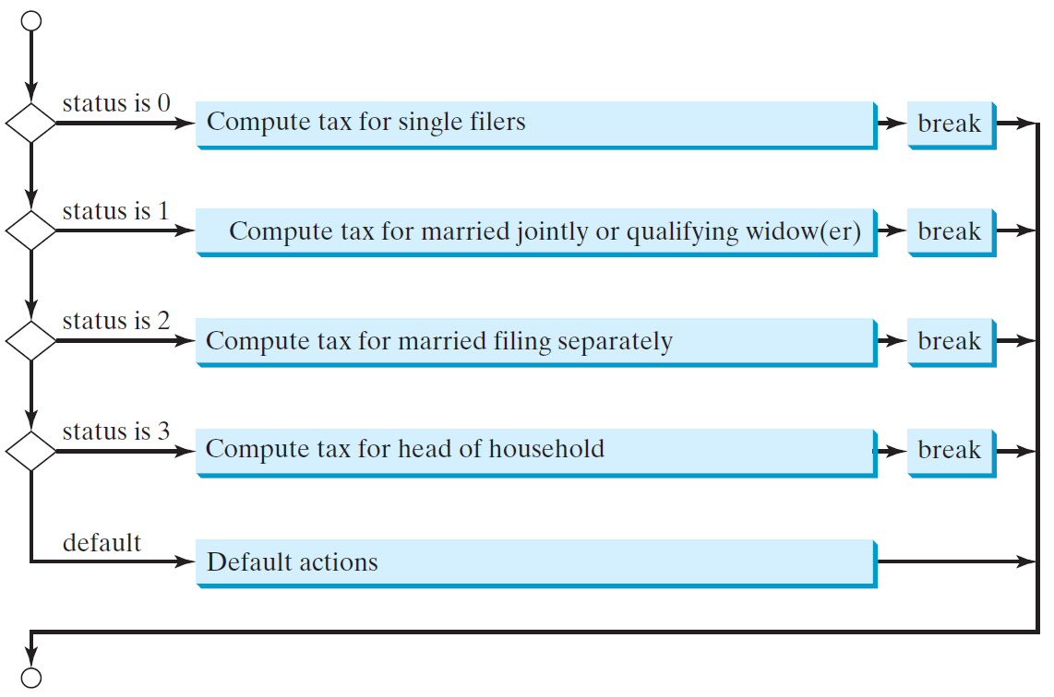
switch Statement Flow Chart

Slide 17
switch Statement Rules
The switch-expression must yield a value of char, byte, short, or int type and must always be enclosed in parentheses.
switch (switch-expression) {
case value1: statement(s)1;
break;
case value2: statement(s)2;
break;
…
case valueN: statement(s)N;
break;
default: statement(s)-for-default;
}
The value1, ..., and valueN must have the same data type as the value of the switch-expression.
The resulting statements in the case statement are executed when the value in the case statement matches the value of the switch-expression.
Note that value1, ..., and valueN are constant expressions, meaning that they cannot contain variables in the expression, such as 1 + x.

Slide 18

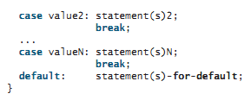
switch Statements

Slide 19
Switch- Example
int number=20;
//Switch expression
switch(number){
//Case statements
case 10: System.out.println("10");
break;
case 20: System.out.println("20");
break;
case 30: System.out.println("30");
break;
//Default case statement
default:System.out.println("Not in 10, 20 or 30");
}

Slide 20
switch Statement Rules
The keyword break is optional, but it should be used at the end of each case in order to terminate the remainder of the switch statement. If the break statement is not present, the next case statement will be executed.
switch (switch-expression) {
case value1: statement(s)1;
break;
case value2: statement(s)2;
break;
…
case valueN: statement(s)N;
break;
default: statement(s)-for-default;
}
The default case, which is optional, can be used to perform actions when none of the specified cases matches the switch-expression.
When the value in a case statement matches the value of the switch-expression, the statements starting from this case are executed until either a break statement or the end of the switch statement is reached.

Slide 21
Trace switch statement
Suppose day is 2:
switch (day) {
case 1:
case 2:
case 3:
case 4:
case 5: System.out.println("Weekday"); break;
case 0:
case 6: System.out.println("Weekend");
}

Slide 22
Trace switch statement
Match case 2
switch (day) {
case 1:
case 2:
case 3:
case 4:
case 5: System.out.println("Weekday"); break;
case 0:
case 6: System.out.println("Weekend");
}

Slide 23
Trace switch statement
Fall through case 3
switch (day) {
case 1:
case 2:
case 3:
case 4:
case 5: System.out.println("Weekday"); break;
case 0:
case 6: System.out.println("Weekend");
}

Slide 24
Trace switch statement
Fall through case 4
switch (day) {
case 1:
case 2:
case 3:
case 4:
case 5: System.out.println("Weekday"); break;
case 0:
case 6: System.out.println("Weekend");
}

Slide 25
Trace switch statement
Fall through case 5
switch (day) {
case 1:
case 2:
case 3:
case 4:
case 5: System.out.println("Weekday"); break;
case 0:
case 6: System.out.println("Weekend");
}

Slide 26
Trace switch statement
Encounter break
switch (day) {
case 1:
case 2:
case 3:
case 4:
case 5: System.out.println("Weekday"); break;
case 0:
case 6: System.out.println("Weekend");
}

Slide 27
Trace switch statement
Exit the statement
switch (day) {
case 1:
case 2:
case 3:
case 4:
case 5: System.out.println("Weekday"); break;
case 0:
case 6: System.out.println("Weekend");
}

Slide 28
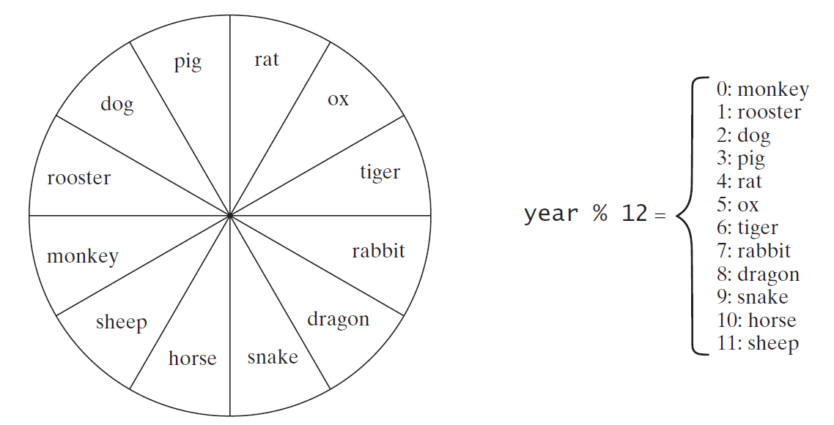
Problem: Chinese Zodiac
Write a program that prompts the user to enter a year and displays the animal for the year.

Slide 29
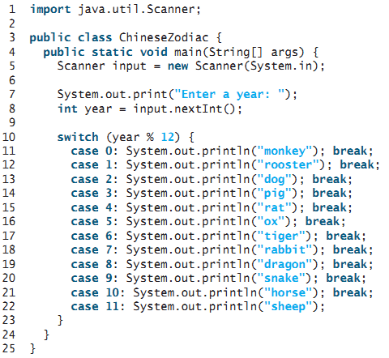



Slide 30
Logical Operators
The logical operators !, &&, ||, and ^ can be used to create a compound Boolean expression
Logical operators, also known as Boolean operators
Operator | Name | Description
! | not | logical negation
&& | and | logical conjunction
|| | or | logical disjunction
^ | exclusive or | logical exclusion

Slide 31
Truth Table for Operator !
p | !p | Example (assume age = 24, weight = 140)
true | false | !(age > 18) is false, because (age > 18) is true.
false | true | !(weight == 150) is true, because (weight == 150) is false.

Slide 32
Truth Table for Operator &&
p₁ | p₂ | p₁ && p₂ | Example (assume age = 24, weight = 140)
false | false | false | (age <= 18) && (weight < 140) is false, because (age > 18) and (weight <= 140) are both false.
false | true | false
true | false | false | (age > 18) && (weight > 140) is false, because (weight > 140) is false.
true | true | true | (age > 18) && (weight >= 140) is true, because both (age > 18) and (weight >= 140) are true.

Slide 33
Truth Table for Operator ||
p₁ | p₂ | p₁ || p₂ | Example (assume age = 24, weight = 140)
false | false | false
false | true | true | (age > 34) || (weight <= 140) is true, because (age > 34) is false, but (weight <= 140) is true.
true | false | true | (age > 14) || (weight >= 150) is false, because (age > 14) is true.
true | true | true

Slide 34
Truth Table for Operator ^
p₁ | p₂ | p₁ ^ p₂ | Example (assume age = 24, weight = 140)
false | false | false | (age > 34) ^ (weight > 140) is true, because (age > 34) is false and (weight > 140) is false.
false | true | true | (age > 34) ^ (weight >= 140) is true, because (age > 34) is false but (weight >= 140) is true.
true | false | true | (age > 14) ^ (weight > 140) is true, because (age > 14) is true and (weight > 140) is false.
true | true | false

Slide 35


Whether a number is divisible by 2 and 3, by 2 or 3, and by 2 or 3 but not both
import java.util.Scanner;
public class TestBooleanOperators {
public static void main(String[] args) {
Scanner input = new Scanner(System.in);
// Receive an input
System.out.print("Enter an integer: ");
int number = input.nextInt();
if (number % 2 == 0 && number % 3 == 0)
System.out.println(number + " is divisible by 2 and 3.");
if (number % 2 == 0 || number % 3 == 0)
System.out.println(number + " is divisible by 2 or 3.");
if (number % 2 == 0 ^ number % 3 == 0)
System.out.println(number + " is divisible by 2 or 3, but not both.");
}
}

Slide 36
Conditional Expressions
A conditional expression evaluates an expression based on a condition.
Conditional expressions are in a completely different style
Syntax :
boolean-expression ? expression1 : expression2;
Example-1
if (x > 0)
y = 1;
else
y = -1;
Can be written as
y = (x > 0)? 1 : -1;
MaxNum-Example
max = (num1 > num2) ? num1 : num2;

Slide 37


Operator Precedence and Associativity
Operator precedence and associativity determine the order in which operators are evaluated
If operators with the same precedence are next to each other, their associativity determines the order of evaluation
All binary operators except assignment operators are left associative
Assignment operators are right associative

Slide 38
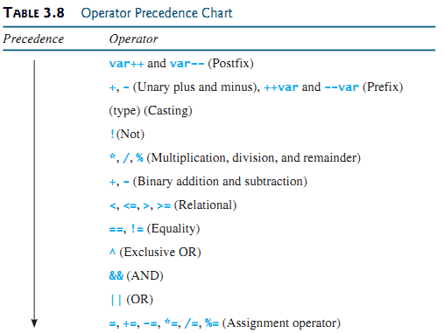
Operator Precedence and Associativity

Slide 39
Example
true || true && false
true && true || false
2 * 2 - 3 > 2 && 4 - 2 > 5
2 * 2 - 3 > 2 || 4 - 2 > 5
Is x > 0 && x < 10 the same as(x > 0) && (x < 10) ?
Is (x > 0 || x < 10) the same as ((x > 0) || (x < 10))?
Is (x > 0 || x < 10 && y < 0) the same as (x > 0 || (x < 10 && y < 0))?
3 + 4 * 4 > 5 * (4 + 3) – 1 && (4 - 3 > 5)

Slide 40
Summary
Nested if and Multi way if statements and switch statement
Logical Operators
Conditional Expression

Slide 41
Next Lecture
Repetition Structure

